Slide 1

Chapter 6
Delivery and
Forwarding of
IP Packets
TCP/IP Protocol Suite
Copyright © The McGraw-Hill Companies, Inc. Permission required for reproduction or display.

Slide 2
OBJECTIVES:
To discuss the delivery of packets in the network layer and distinguish between direct and indirect delivery.
To discuss the forwarding of packets in the network layer and distinguish between destination-address–based forwarding and label-based forwarding.
To discuss different forwarding techniques, including next-hop, network-specific, host-specific, and default.
To discuss the contents of routing tables in classful and classless addressing and some algorithms used to search the tables.
TCP/IP Protocol Suite

Slide 3
Chapter
Outline
6.1 Delivery
6.2 Forwarding
TCP/IP Protocol Suite

Slide 4
6-1 DELIVERY
The network layer supervises the handling of the packets by the underlying physical networks. We define this handling as the delivery of a packet. The delivery of a packet to its final destination is accomplished using two different methods of delivery:
Direct and Indirect.
TCP/IP Protocol Suite

Slide 5
Topics Discussed in the Section
Direct Delivery
Indirect Delivery
TCP/IP Protocol Suite

Slide 6
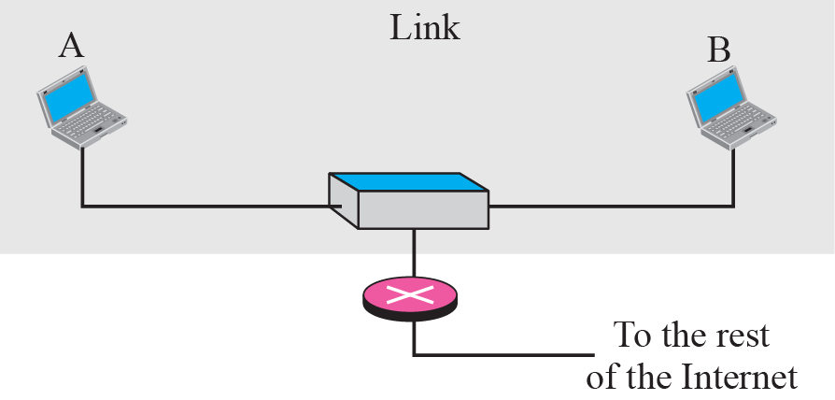
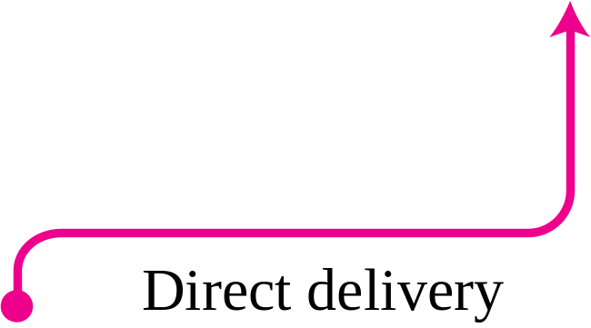
Figure 6.1 Direct delivery
In direct Delivery, the final destination of packet is a host connected to the same physical network as the deliverer.
TCP/IP Protocol Suite

Slide 7
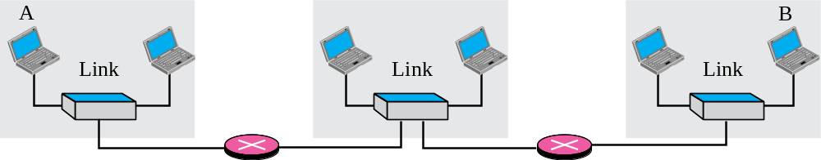
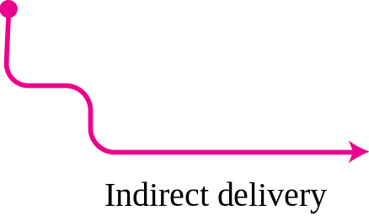
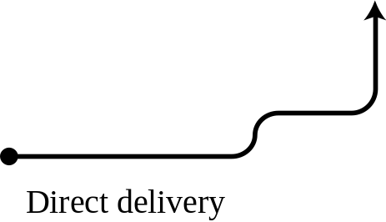

Figure 6.2 Indirect delivery
In an Indirect delivery, the packet goes from router to router until it reaches the one connected to the same physical network as its final destination.
TCP/IP Protocol Suite

Slide 8
6-2 FORWARDING
Forwarding means to place the packet in its route to its destination. Since the Internet today is made of a combination of links (networks), forwarding means to deliver the packet to the next hop (which can be the final destination or the intermediate connecting device). Although the IP protocol was originally designed as a connectionless protocol, today the tendency is to use IP as a connection-oriented protocol.
TCP/IP Protocol Suite

Slide 9
Topics Discussed in the Section
Forwarding Based on Destination Address
  Next Hop method
  Network Specific method
  Host-Specific Method
  Default method
Forwarding Based on Label
TCP/IP Protocol Suite

Slide 10
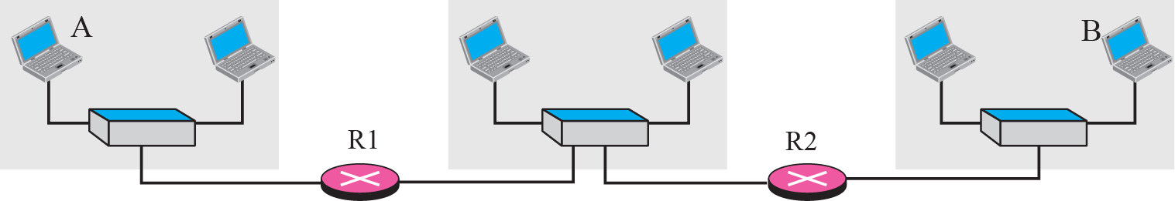
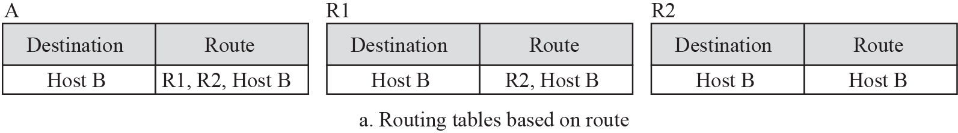
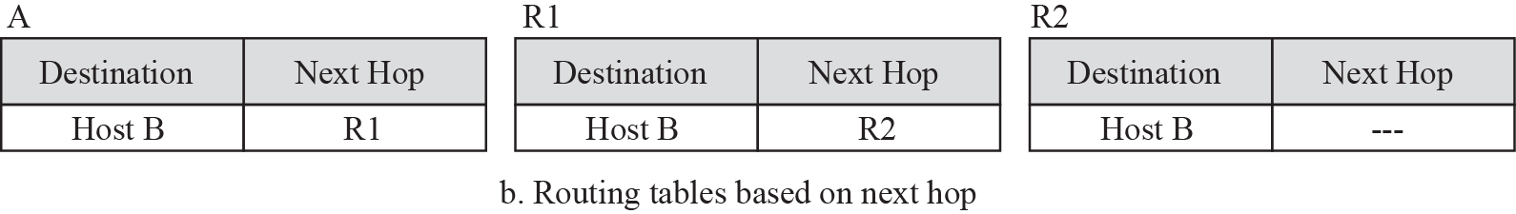
Figure 6.3 Next-hop method
TCP/IP Protocol Suite

Slide 11
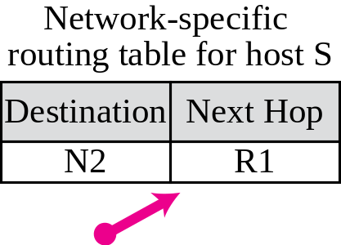
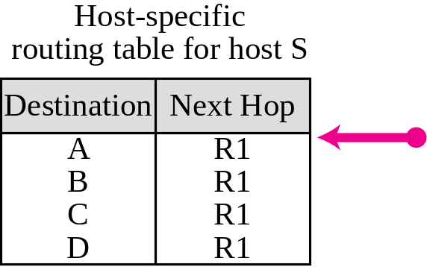
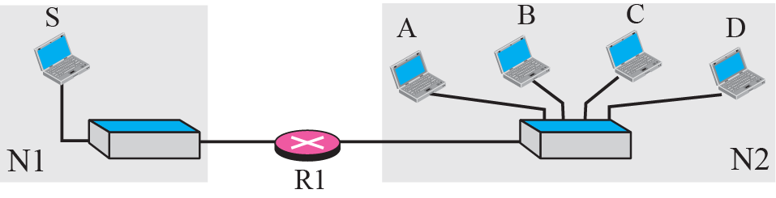
Figure 6.4 Network-specific method
TCP/IP Protocol Suite
Notes:
Host-specific
routing table for host SNext HopR1
R1
R1
R1DestinationA
B
C

Slide 12
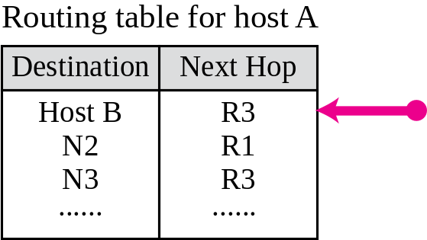
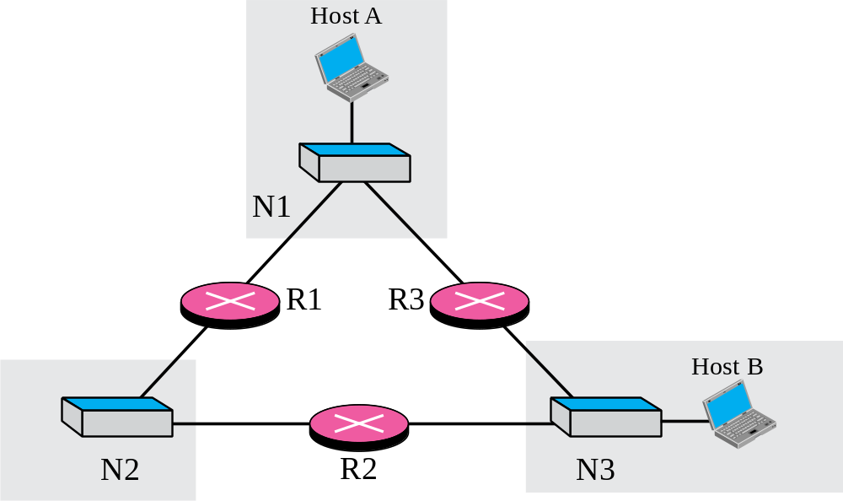
Figure 6.5 Host-specific routing
TCP/IP Protocol Suite

Slide 13
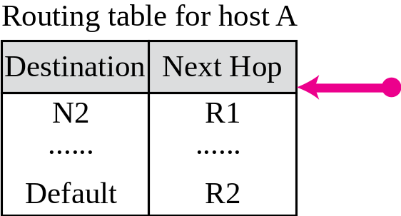
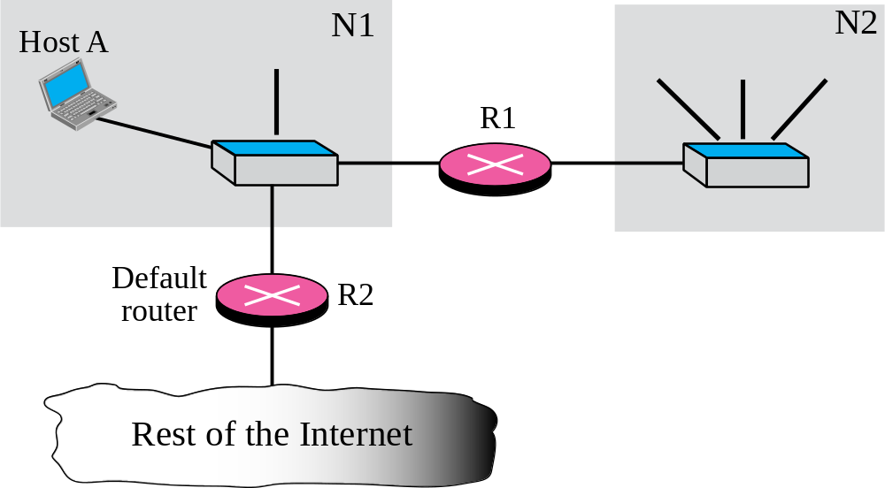
Figure 6.6 Default routing
TCP/IP Protocol Suite

Slide 14
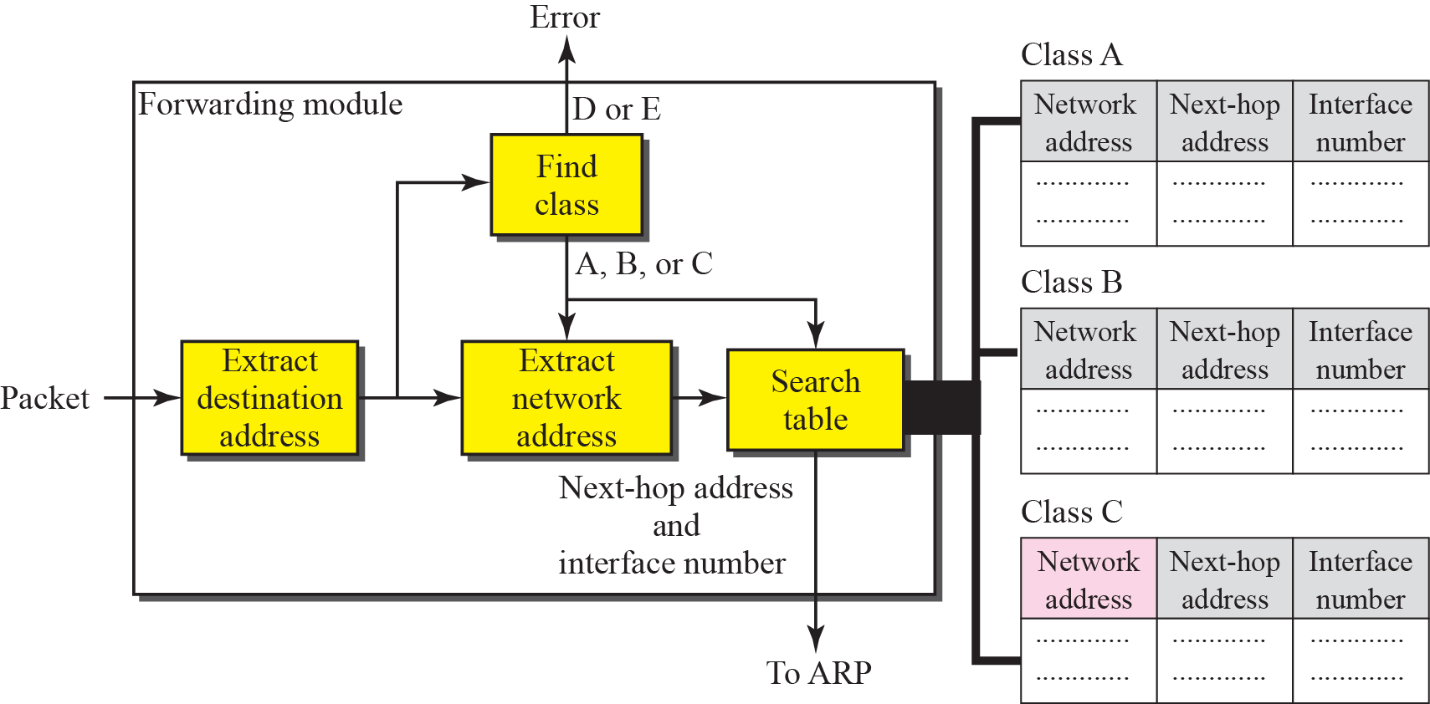
Figure 6.7 Simplified forwarding module in classful address without subnetting
TCP/IP Protocol Suite

Slide 15
Example 6.1
Figure 6.8 shows an imaginary part of the Internet. Show the routing tables for router R1.
Solution
Figure 6.9 shows the three tables used by router R1. Note that some entries in the next-hop address column are empty because in these cases, the destination is in the same network to which the router is connected (direct delivery). In these cases, the next-hop address used by ARP is simply the destination address of the packet as we will see in Chapter 8.
TCP/IP Protocol Suite

Slide 16
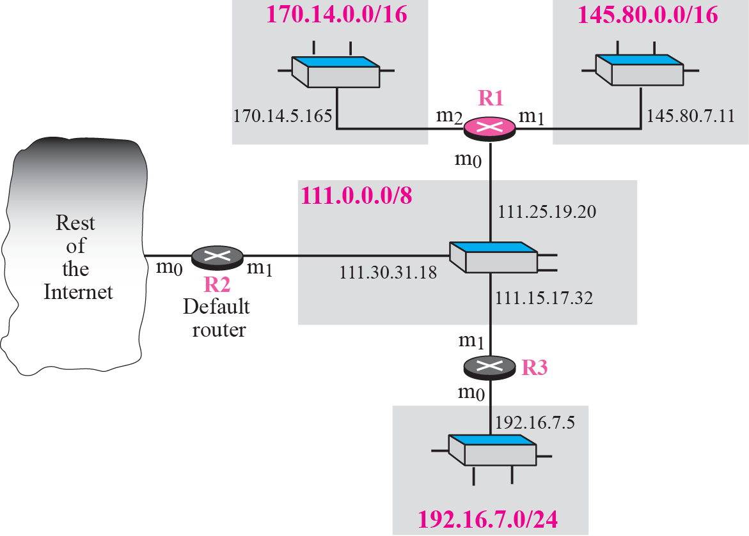
Figure 6.8 Configuration for routing, Example 6.1
TCP/IP Protocol Suite

Slide 17
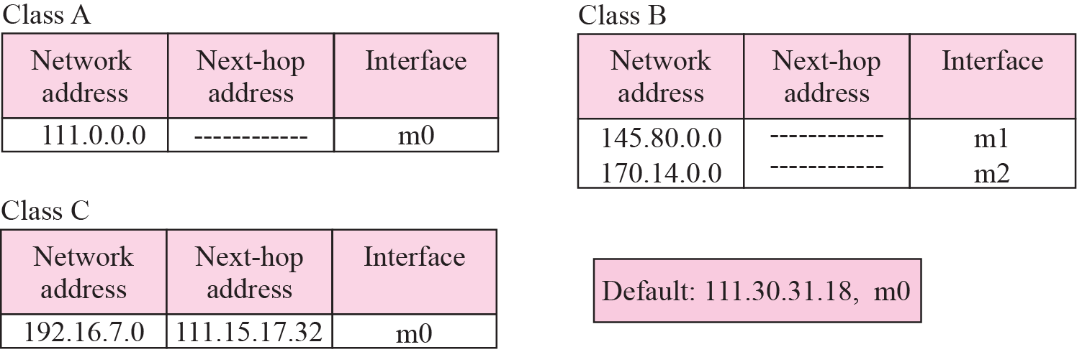
Figure 6.9 Tables for Example 6.1
TCP/IP Protocol Suite

Slide 18
Example 6.2
Router R1 in Figure 6.8 receives a packet with destination address 192.16.7.14. Show how the packet is forwarded.
Solution
The destination address is
11000000 00010000 000001110 0001110.
The destination network is class C. The network address is extracted by masking off the leftmost 24 bits of the destination address; the result is 192.16.7.0. The table for Class C is searched. The network address is found in the first row. The next-hop address 111.15.17.32. and the interface m0 are passed to ARP (see Chapter 8).
TCP/IP Protocol Suite

Slide 19
Example 6.3
Router R1 in Figure 6.8 receives a packet with destination address 167.24.160.5. Show how the packet is forwarded.
Solution
The destination address in binary is
10100111 00011000 10100000 00000101.
The class is B. The network address can be found by masking off 16 bits of the destination address, the result is 167.24.0.0. The table for Class B is searched. No matching network address is found. The packet needs to be forwarded to the default router (the network is somewhere else in the Internet). The next-hop address 111.30.31.18 and the interface number m0 are passed to ARP.
TCP/IP Protocol Suite

Slide 20
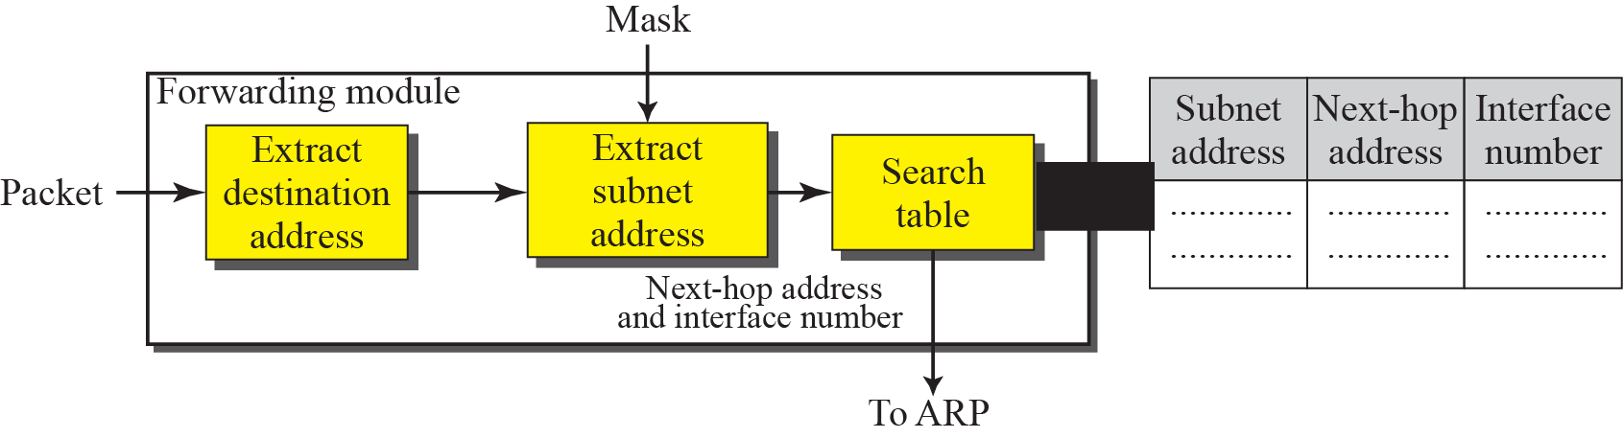
Figure 6.10 Simplified forwarding module in classful address with subnetting
TCP/IP Protocol Suite

Slide 21
Example 6.4
Figure 6.11 shows a router connected to four subnets.
Note several points. First, the site address is 145.14.0.0/16 (a class B address). Every packet with destination address in the range 145.14.0.0 to 145.14.255.255 is delivered to the interface m4 and distributed to the final destination subnet by the router. Second, we have used the address x.y.z.t/n for the interface m4 because we do not know to which network this router is connected. Third, the table has a default entry for packets that are to be sent out of the site. The router is configured to apply the subnet mask /18 to any destination address.
TCP/IP Protocol Suite

Slide 22
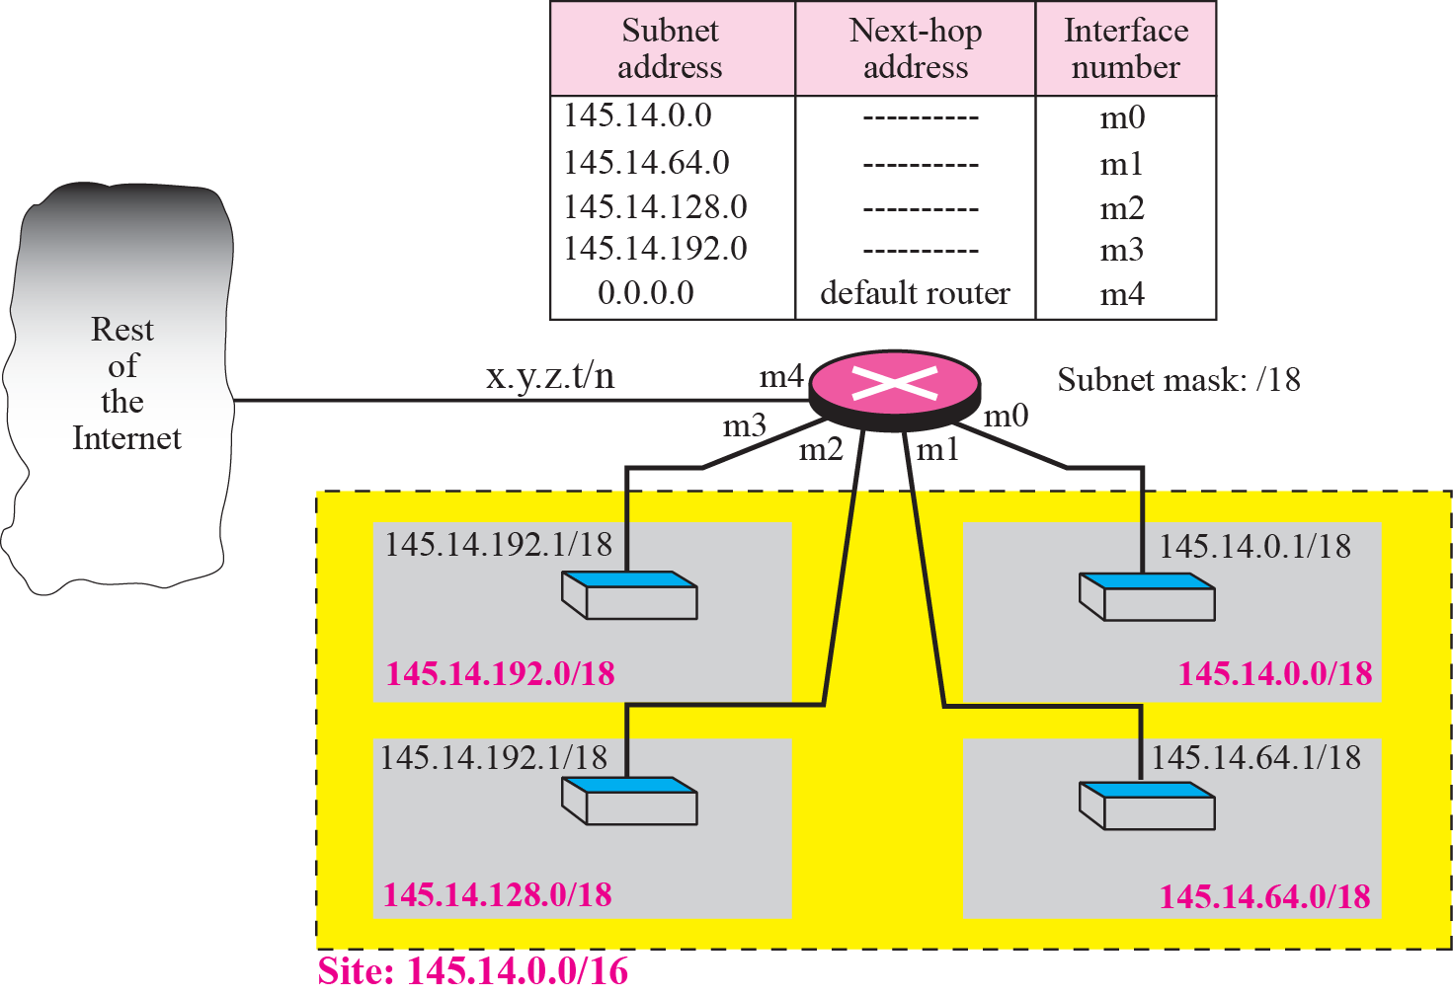
Figure 6.11 Configuration for Example 6.4
TCP/IP Protocol Suite

Slide 23
Example 6.5
The router in Figure 6.11 receives a packet with destination address 145.14.32.78. Show how the packet is forwarded.
Solution
The mask is /18. After applying the mask, the subnet address is 145.14.0.0. The packet is delivered to ARP (see Chapter 8) with the next-hop address 145.14.32.78 and the outgoing interface m0.
TCP/IP Protocol Suite

Slide 24
Example 6.6
A host in network 145.14.0.0 in Figure 6.11 has a packet to send to the host with address 7.22.67.91. Show how the packet
is routed.
Solution
The router receives the packet and applies the mask (/18). The network address is 7.22.64.0. The table is searched and the address is not found. The router uses the address of the default router (not shown in figure) and sends the packet to that router.
TCP/IP Protocol Suite

Slide 25

Note
In classful addressing we can have a routing table with three columns;
in classless addressing,
we need at least four columns.
TCP/IP Protocol Suite

Slide 26
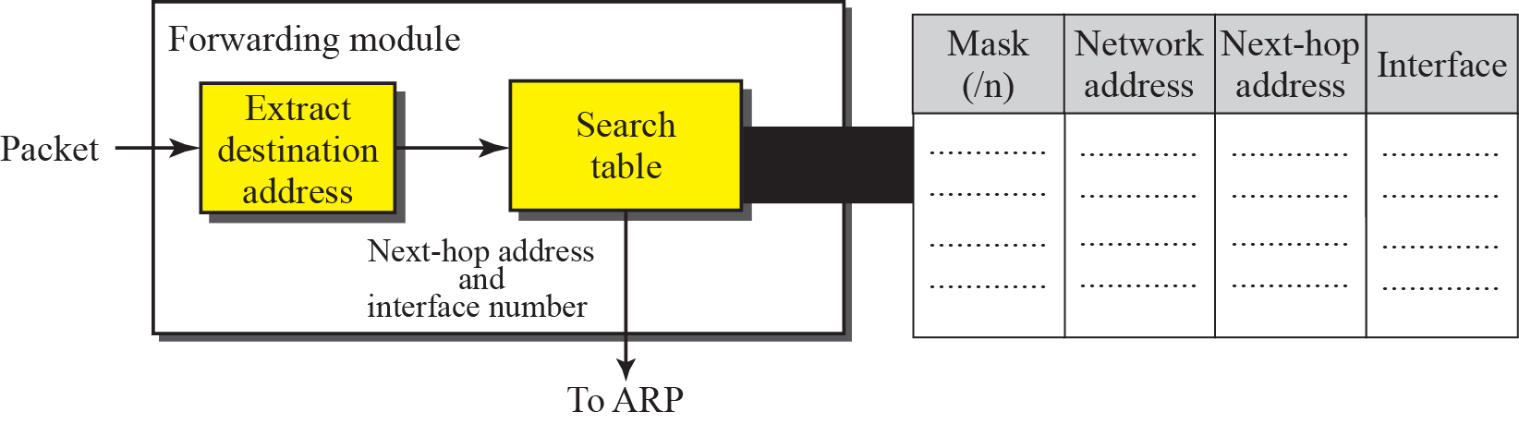
Figure 6.12 Simplified forwarding module in classless address
TCP/IP Protocol Suite

Slide 27
Example 6.7
Make a routing table for router R1 using the configuration in Figure 6.13.
Solution
Table 6.1 shows the corresponding table
TCP/IP Protocol Suite

Slide 28
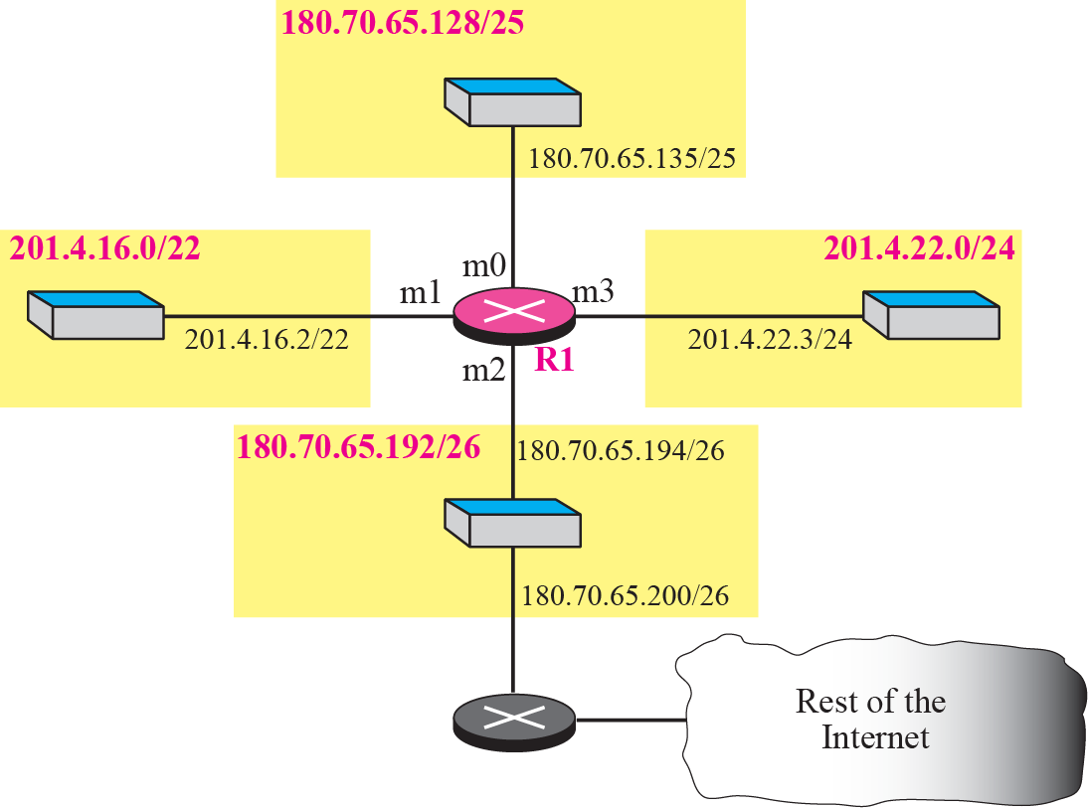
Figure 6.13 Configuration for Example 6.7
TCP/IP Protocol Suite

Slide 29
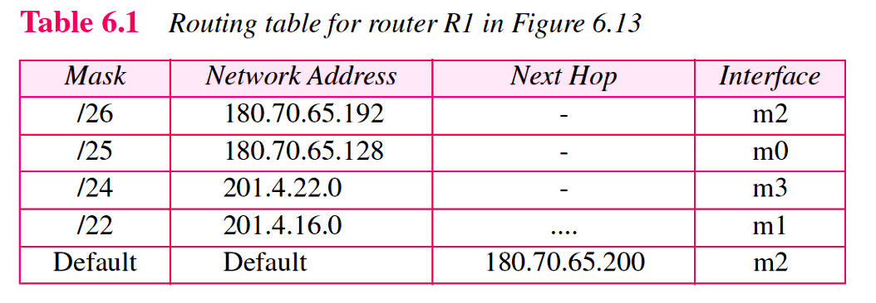
TCP/IP Protocol Suite

Slide 30
Example 6.8
Show the forwarding process if a packet arrives at R1 in Figure 6.13 with the destination address 180.70.65.140.
Solution
The router performs the following steps:
1.The first mask (/26) is applied to the destination address. The result is 180.70.65.128, which does not match the corresponding network address.
2.The second mask (/25) is applied to the destination address. The result is 180.70.65.128, which matches the corresponding network address. The next-hop address (the destination address of the packet in this case) and the interface number m0 are passed to ARP for further processing.
TCP/IP Protocol Suite

Slide 31
Example 6.9
Show the forwarding process if a packet arrives at R1 in Figure 6.13 with the destination address 201.4.22.35.
Solution
The router performs the following steps:
1.The first mask (/26) is applied to the destination address. The result is 201.4.22.0, which does not match the corresponding network address (row 1).
2.The second mask (/25) is applied to the destination address. The result is 201.4.22.0, which does not match the corresponding network address (row 2).
3. The third mask (/24) is applied to the destination address. The result is 201.4.22.0, which matches the corresponding network address.
TCP/IP Protocol Suite

Slide 32
Example 6.10
Show the forwarding process if a packet arrives at R1 in Figure 6.13 with the destination address 18.24.32.78.
Solution
This time all masks are applied to the destination address, but no matching network address is found. When it reaches the end of the table, the module gives the next-hop address 180.70.65.200 and interface number m2 to ARP (see Chapter 8). This is probably an outgoing package that needs to be sent, via the default router, to someplace else in the Internet.
TCP/IP Protocol Suite

Slide 33
Example 6.11
Now let us give a different type of example. Can we find the configuration of a router if we know only its routing table? The routing table for router R1 is given in Table 6.2. Can we draw its
topology?
Solution
We know some facts but we don’t have all for a definite topology. We know that router R1 has three interfaces: m0, m1, and m2. We know that there are three networks directly connected to router R1. We know that there are two networks indirectly connected to R1. There must be at least three other routers involved (see next-hop column). We do not know if network 140.6.12.64 is connected to router R3 directly or through a point-to-point network (WAN) and another router. Figure 6.14 shows our guessed topology.
TCP/IP Protocol Suite

Slide 34
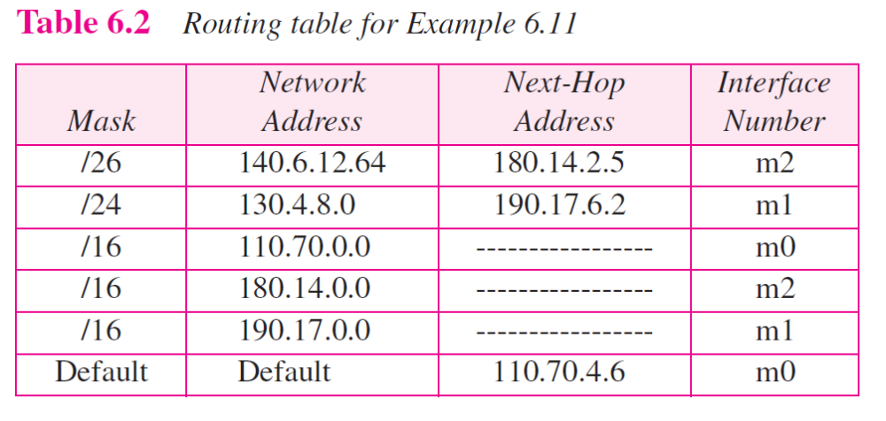
TCP/IP Protocol Suite

